Slide 1
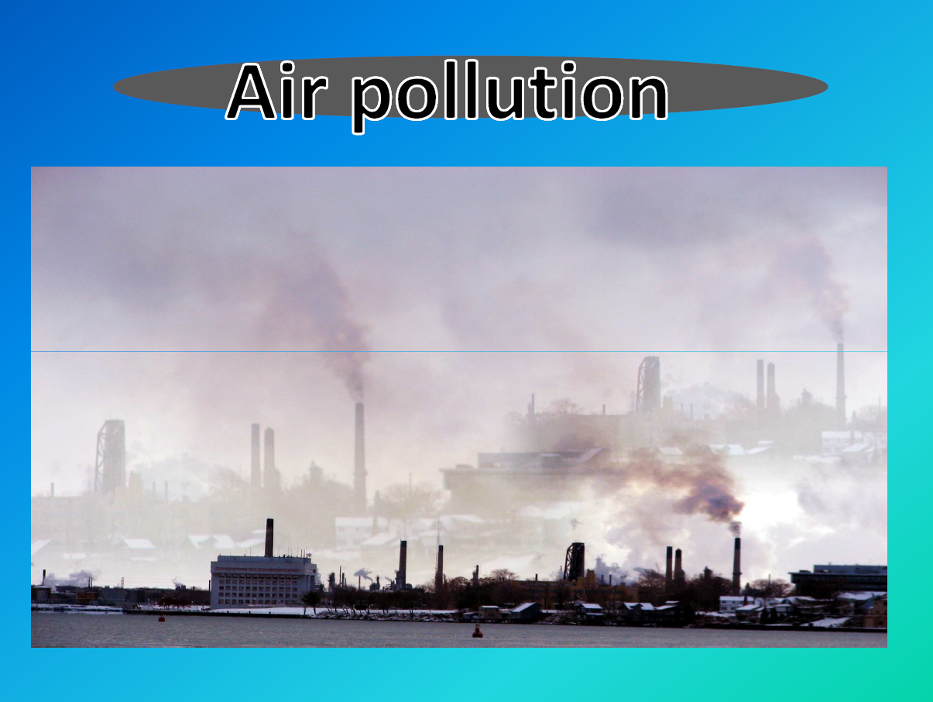

Slide 2
Why study air pollution ?
Causes health problems
Causes visibility problems
Causes agricultural and plant damage
Causes degradation of buildings
Causes odors
Causes climate change
Various other reasons …

Slide 3
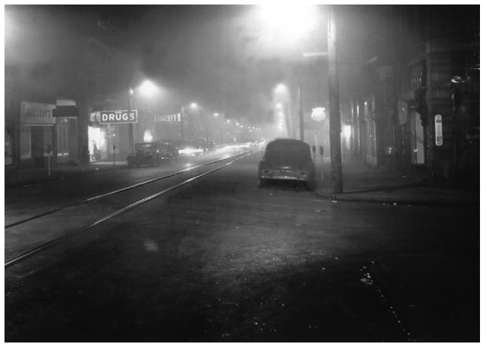
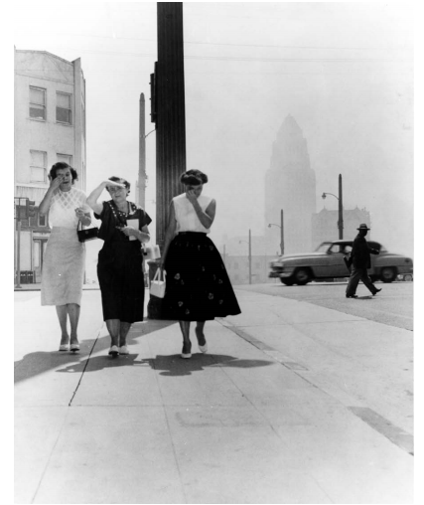
Los Angeles (1950s)
Noontime, Donora, Pennsylvania, October 29, 1948
Copyright Photo Archive/Pittsburgh Post-Gazette, 2001. All rights reserved
Hollywood Citizens News Collection, Los Angeles Public Library

Slide 4
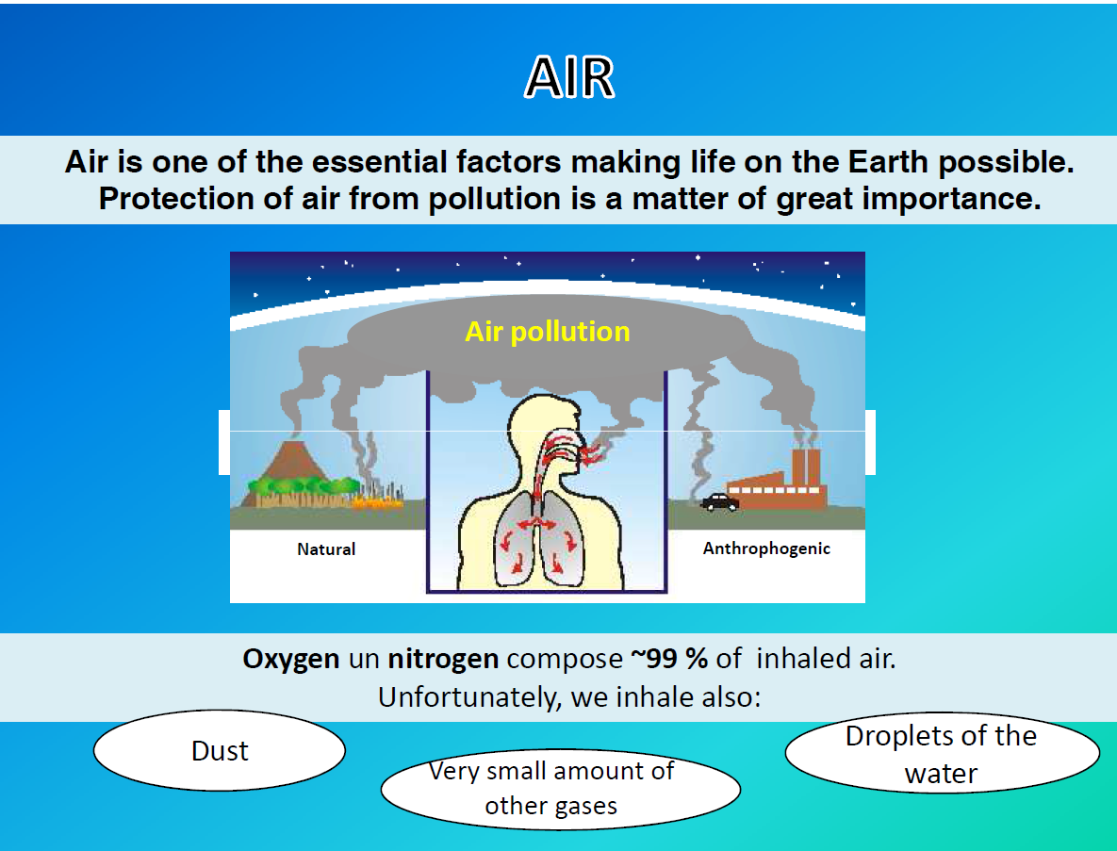

Slide 5
Air Pollution: A Common Working Definition …
“Air pollution occurs when gases or aerosol particles, emitted anthropogenically, build up in concentrations sufficiently high to cause direct or indirect damage to humans, plants, animals, other life forms, ecosystems, structures, or works of art.”
Main things …
Air pollution concentration is the important thing to know …
“Concentrations sufficiently high” implies a concentration threshold beyond which we can anticipate a realistic possibility of damage to health, ecosystems, etc …
Threshold is often also called a “level of concern” or “standard”
Relevant Question: Is pollution level below or above threshold?

Slide 6
Air Pollution Concentration (Two main ways this is expressed…)
Ambient air quality standards, those that deal with concentrations of pollutants in the
outdoor atmosphere
Source performance standards, those that apply to emissions of pollutants from specific sources
mass emissions per unit of time or unit of production, such as grams per minute or kilograms of pollutant per ton of product.
Mass Per Unit Volume
– Mass of air pollutant per cubic meter of air
– Used for solid, liquid and gaseous air pollutants
– Grams per cubic meter (g/m3)
– Milligrams per cubic meter (mg/m3) = 0.001 g/m3
• Parts Per Million (ppm)
– of molecules of air pollutant per million molecules of air
– Used for gaseous air pollutants
– 1 part per billion (ppb) = 0.001 ppm
– 1 part per trillion (ppt) = 0.001 ppb = 1.0 × 10⁻⁶ ppm

Slide 7
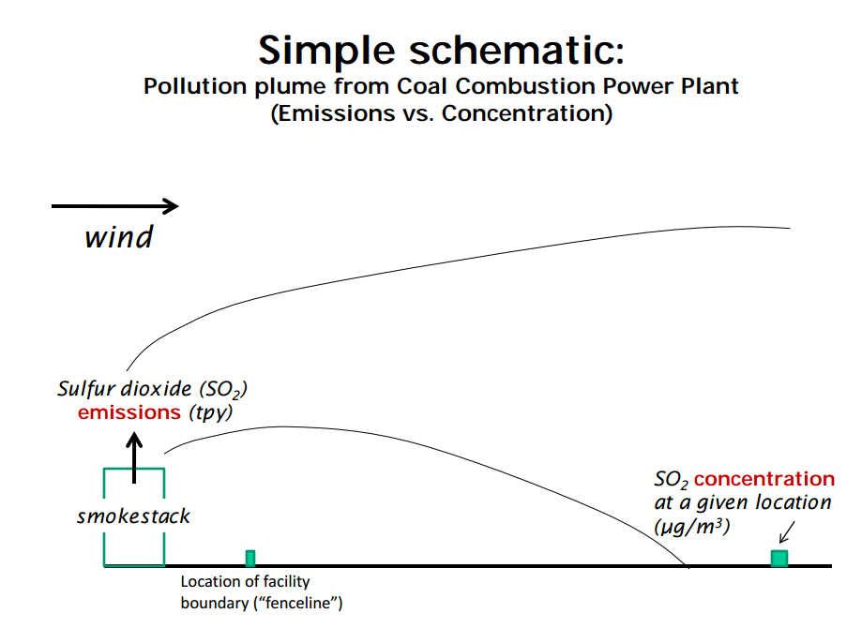

Slide 8
Express the following situations in terms of the air pollution concentration (use metric units).
500 mg of carbon monoxide in a 10 ft x 10 ft x 10 ft room
= 500mg/(3.048m)³=500 mg/28.317 m³ = 17.657 mg/m³
2. 10 milligrams of ozone in a 1000 cubic-meter warehouse
= 10 mg/1000 m³ = 0.01 mg/m³ = 10 µg/m³

Slide 9
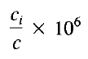
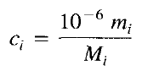
Conversion of one ambient air quality standards to other :
Parts per million by volume is
where c_{i} and c are moles per volume of species i and air, respectively, at pressure p and temperature T
Given a pollutant mass concentration m_{i}; expressed in μg/m⁻³
where Mi is the molecular weight of species i and c = p / RT.

Slide 10
If T is in kelvin and pressure (p) in pascal
Examples:
The 24 hour SO₂ NAAQS is 365 μg/m³ . Convert this to ppm at T=298K and
P= 1 atm (1.0133×10⁵ Pa)

Slide 11
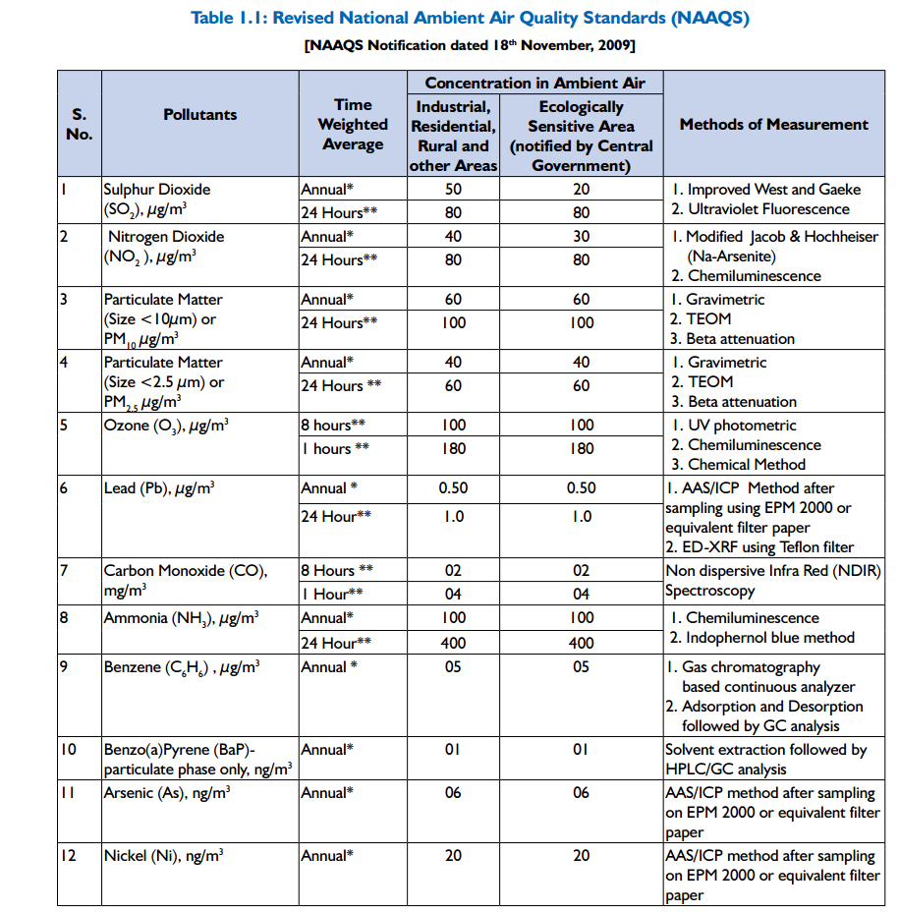
Adopted from : National Ambient air quality monitoring NAAQMS/ 35 /2011-2012

Slide 12
The phenomenon of air pollution involves a sequence of events:
1. The generation of pollutants at and their release from a source:
It involves everything that occurs before the pollutant is released "up the stack" or "out the tailpipe. "
2. The transport, dispersion and chemical transformation in and removal of species from the atmosphere:
This second area thus includes all the chemical and physical processes
that take place between the point of emission and ultimate removal from
the atmosphere.
3. The effects of pollution on human beings, materials, and ecosystems etc.

Slide 13
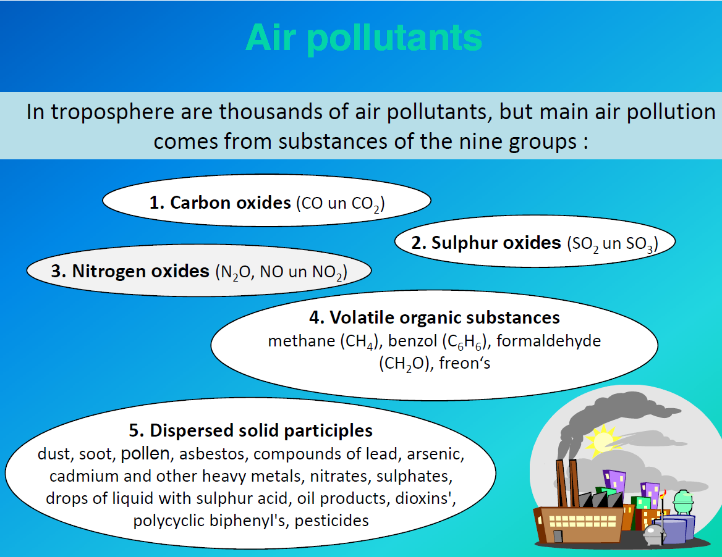

Slide 14
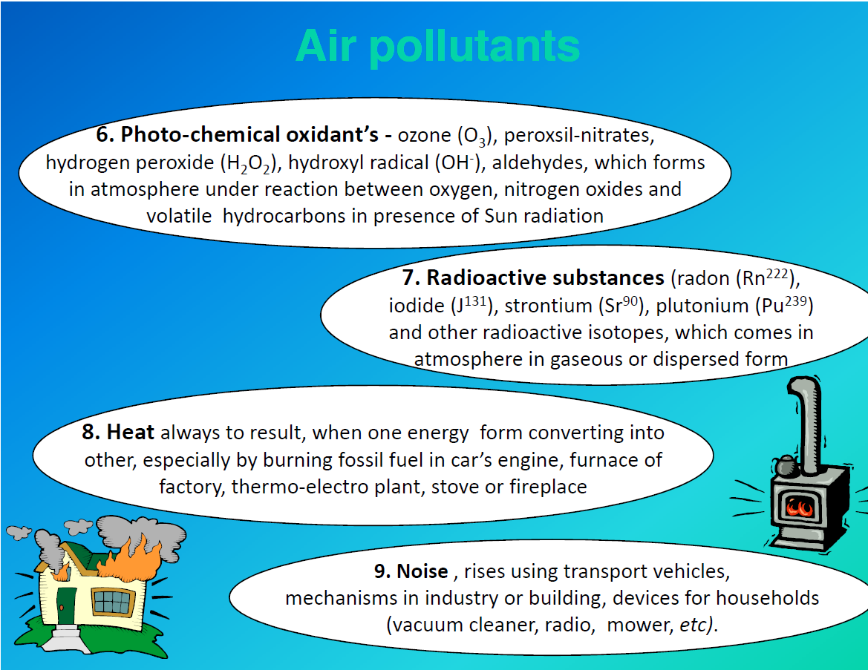

Slide 15
Carbon Monoxide (CO)
It is produced when the carbonaceous fuels are burned under less than ideal condition.
80% of CO emission from the transportation sector.
Hemoglobin has an affinity to the CO than Oxygen
Co readily binds to hemoglobin to form carboxyhemoglobin (COHb)
Oxides of Nitrogen (NO and NO₂)
NOx is created in two ways:
Thermal Nox
It is created when nitrogen and oxygen in the combustion air are heated to a high enough temperature (about 1000 K) to oxidize Nitrogen.
2. Fuel Nox
It results from the oxidation of nitrogen compounds that are chemically bound in the fuel molecules themselves

Slide 16
Sulfur Oxides (SO₂)
Sulfur dioxide (S02) is formed from the oxidation of sulfur contained in fuel as well as
from certain industrial processes that utilize sulfur-containing compounds.
Anthropogenic emissions of S02 result almost exclusively from stationary point sources.
Coal combustion has traditionally been the largest stationary fuel combustion source, although industrial and residential coal use
has declined.
Organic Compounds
Organic air pollutants are sometimes divided according to volatile organic compounds (VOCs) and particulate organic compounds (POCs)
A major source of airborne organic compounds is the emissions from motor vechiles

Slide 17
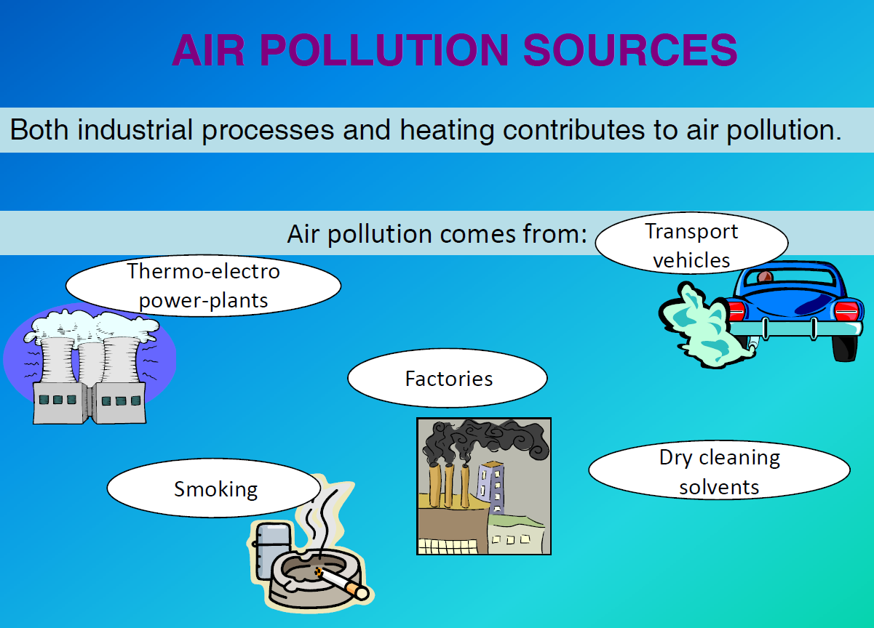

Slide 18
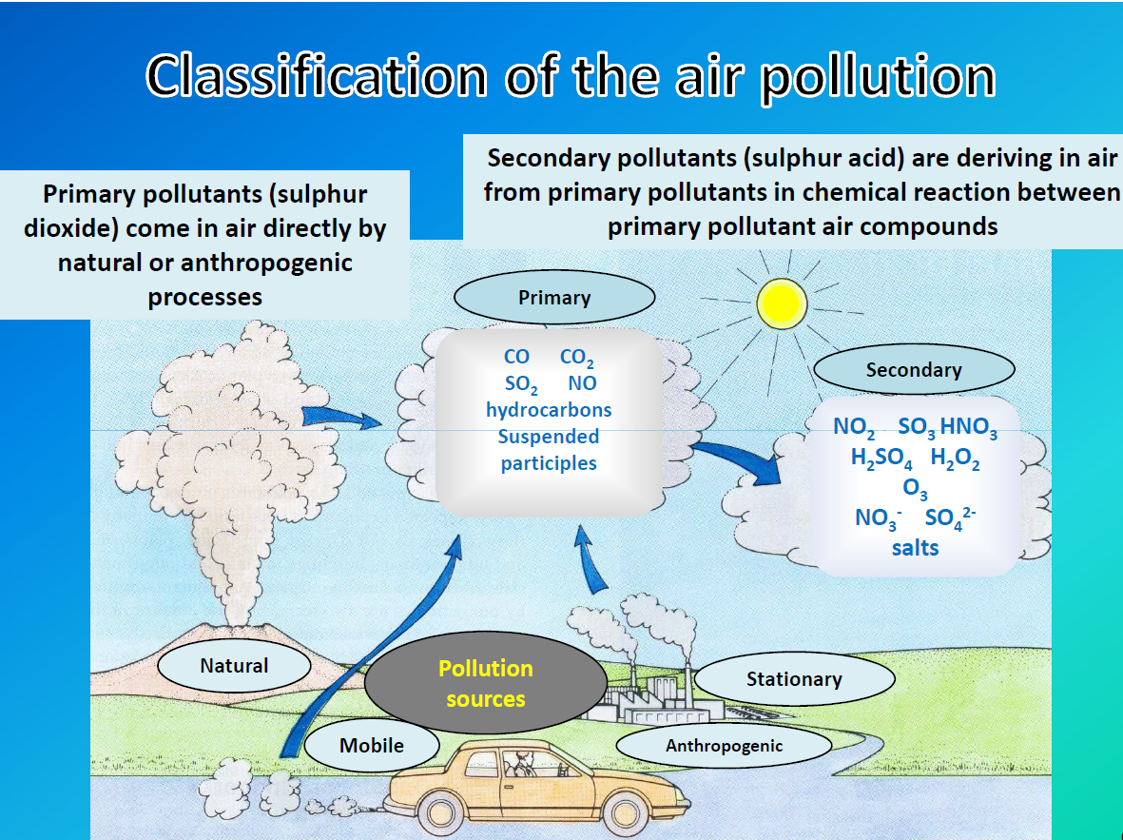

Slide 19
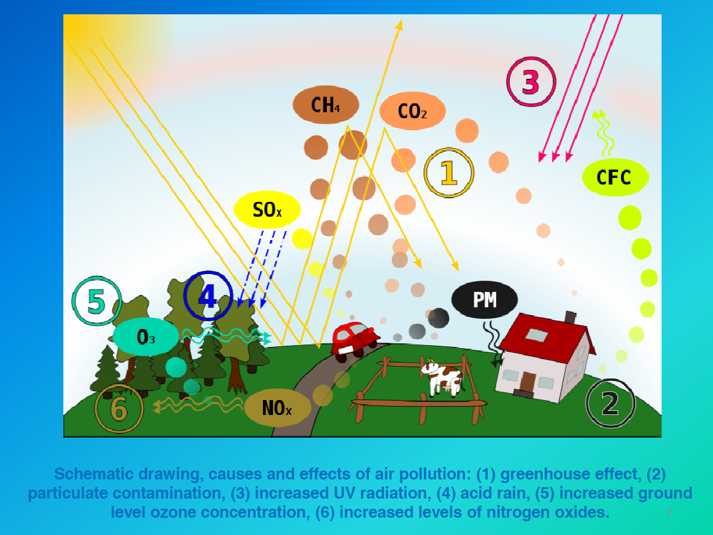

Slide 20
 | Physical Properties | Concentration Level | Anthropogenic sources | Natural sources
SO₂ | Colorless gas with irritating, pungent odor; detectable by taste at levels of 0.3 to I ppm; highly soluble in water (10.5 g/lOO cm' at 293 K) | Global background concentration levels in the range 0.04 to 6 ppb | Fuel combustion in stationary sources; industrial process emissions; metal and petroleum refining | Atmospheric oxidation of organic sulfides
NO | Colorless, odorless gas; nonflammable and slightly soluble in water; toxic | Global background level from 10 to 100 ppt; urban levels have been observed as large as 500 ppb | Combustion, (Automobile) | Bacterial action; lightning
NO2 | Reddish-orange-brown gas with sharp, pungent odor; toxic and highly corrosive; absorbs light in visible spectrum | Global background level from 10 to 500 ppt; urban concentrations have reached values exceeding 500 ppb | Combustion

Slide 21
 | Physical Properties | Concentration Level | Anthropogenic sources | Natural sources
CO₂ | Colorless, odorless, nontoxic gas moderately soluble in water | Global background concentration has increased from 290 ppm in 1900 to about 345 ppm in 1985 | Combustion of fossil fuels
CO | Colorless, odorless, flammable, toxic gas, slightly soluble in water | Global average concentration of 0.09 ppm; urban levels in the vicinity of heavily traveled roadways can exceed 100 ppm | Combustion of fossil fuels | Atmospheric oxidation of methane and other biogenic hydrocarbons
O₃ | Colorless, toxic gas, slightly soluble in water | Global background concentrations range from 20 to 60 ppb; polluted urban levels range from 100 to 500 ppb | Formed as a secondary pollutant from atmospheric reactions involving hydrocarbons and oxides nitrogen | transport from stratosphere to troposphere

Slide 22
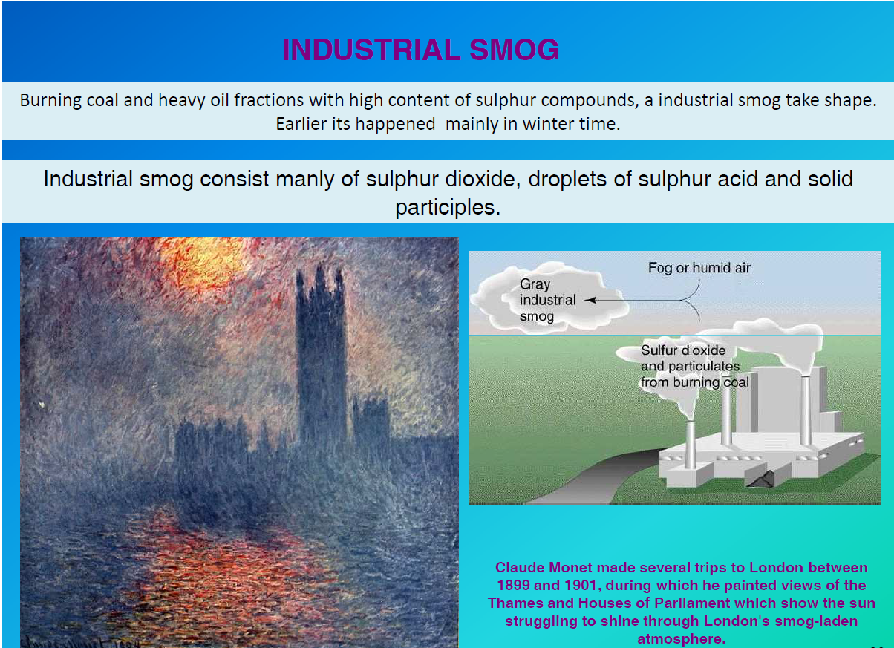
SMOG
Smog is caused by large amounts of coal burning in an area caused by a mixture of smoke, sulphur dioxide and other components

Slide 23
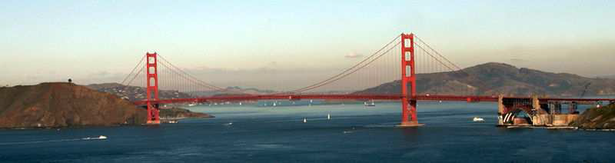
SMOG
Smog is a type of air pollution, derived from emission from internal combustion engines and industrial fumes that react in the atmosphere with sunlight to form secondary pollutants that also combine with the primary emissions to form photochemical smog
Characteristic coloration for smog in California in the beige cloud bank behind Golden Gate Bridge. The brown coloration is due to the NOx in the photochemical smog.

Slide 24
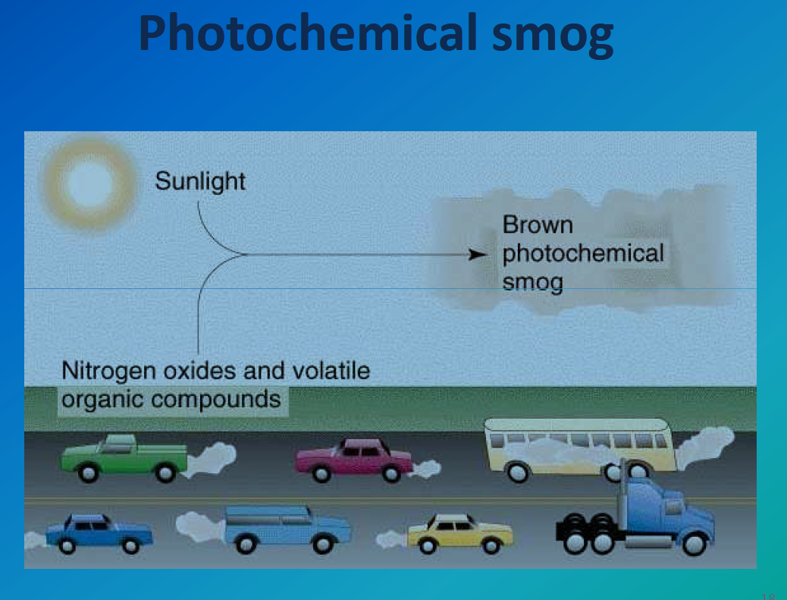
NOx+ VOCs+ Sunlight – Photochemical smog
Formation of NO during combustion:
N2 + O2 - 2NO
2NO+02 – 2NO2

Slide 25
Photochemical reaction:
NO2 +hϒ – NO+ O (Photolysis)
Where hϒ represents the photon (with wavelength < 0.39μm)
O + O2 +M – O3 + M
Where M – represent the Molecule, whose presence is necessary to absorb excess energy from the reaction

Slide 26
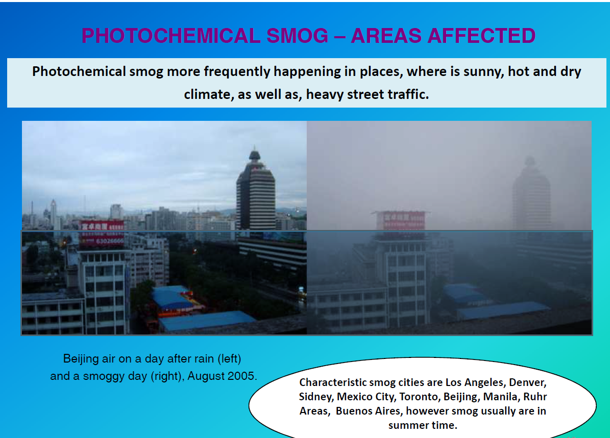
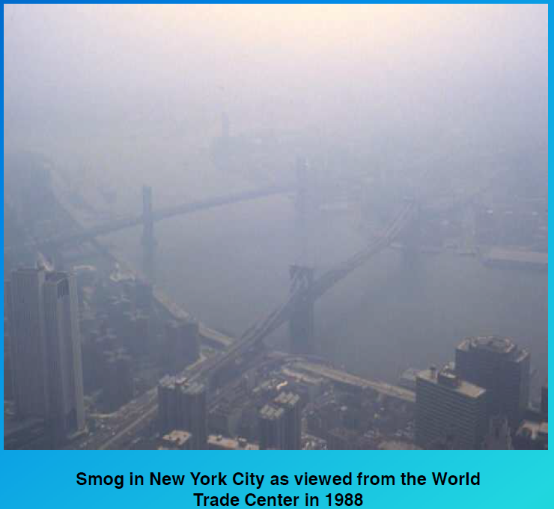
Ozone can convert NO back to NO2
O₃ + NO – NO₂ + O₂

Slide 27
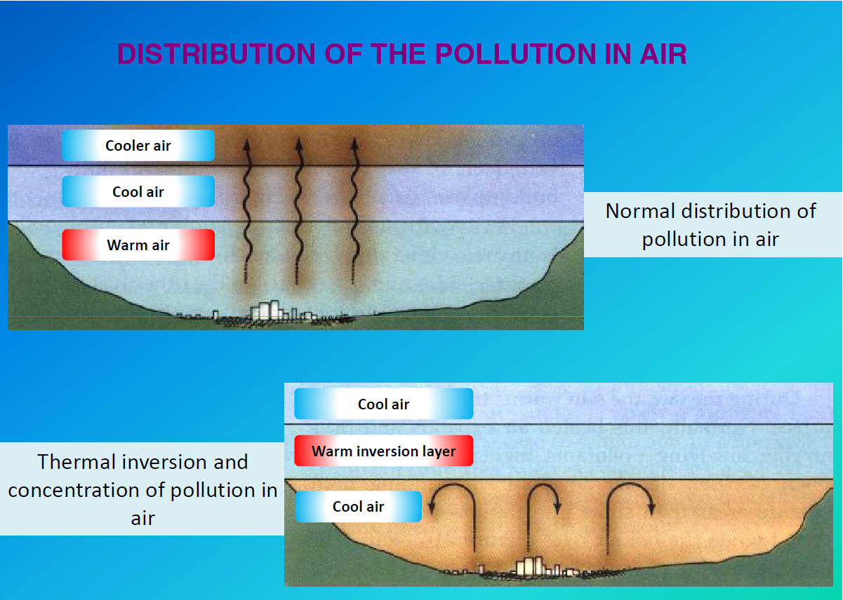

Slide 28
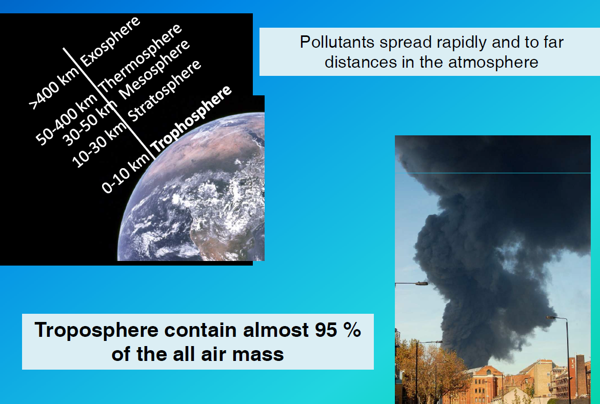
Air Pollution and Meteorology

Slide 29
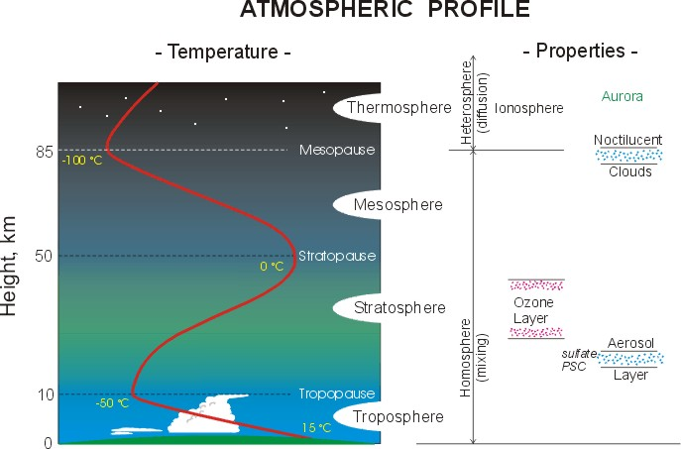

Slide 30
Adiabatic lapse rate
Atmospheric stability
Temperature Inversion
Atmospheric Stability and Mixing Depth

Slide 31
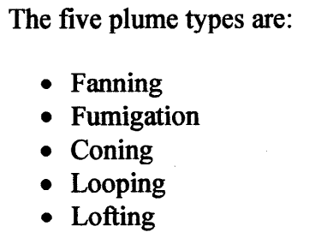
Plume Classification

Slide 32
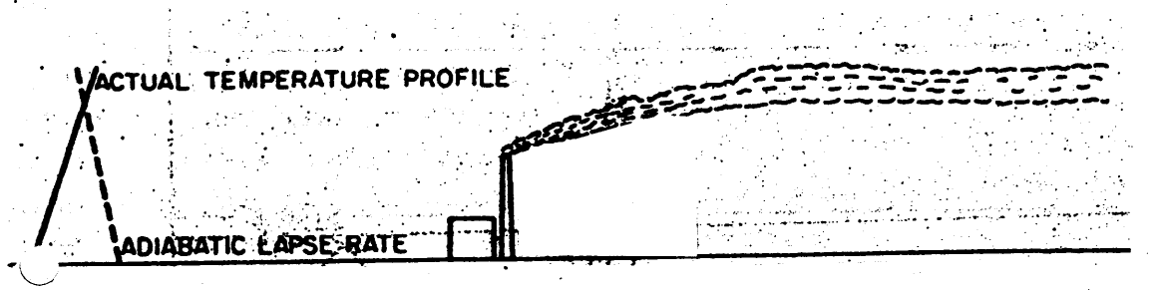
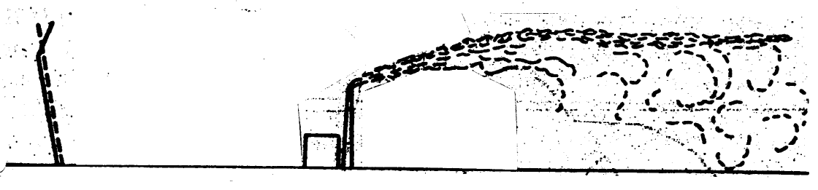
Fanning
On clear night
Fumigation

Slide 33
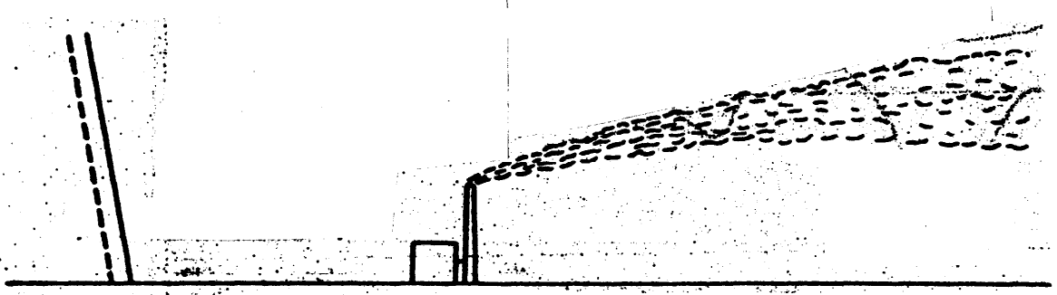
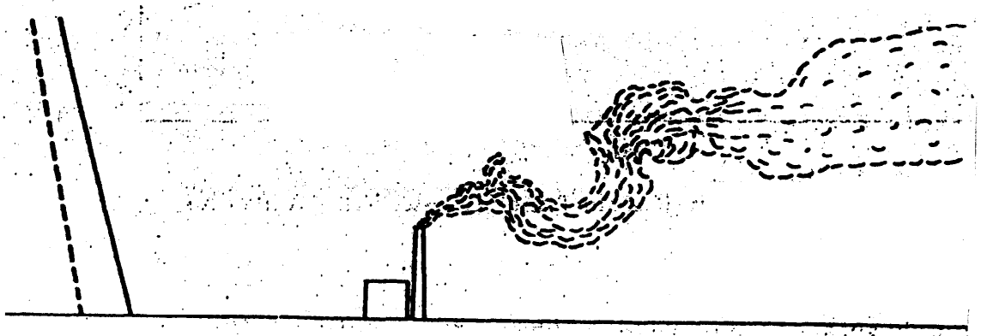
Coning
Looping

Slide 34
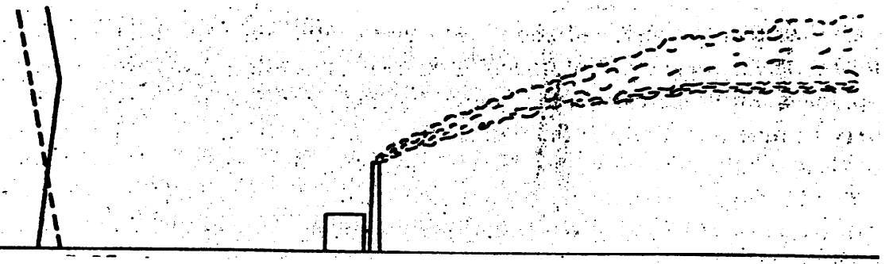
Lofting

Slide 35
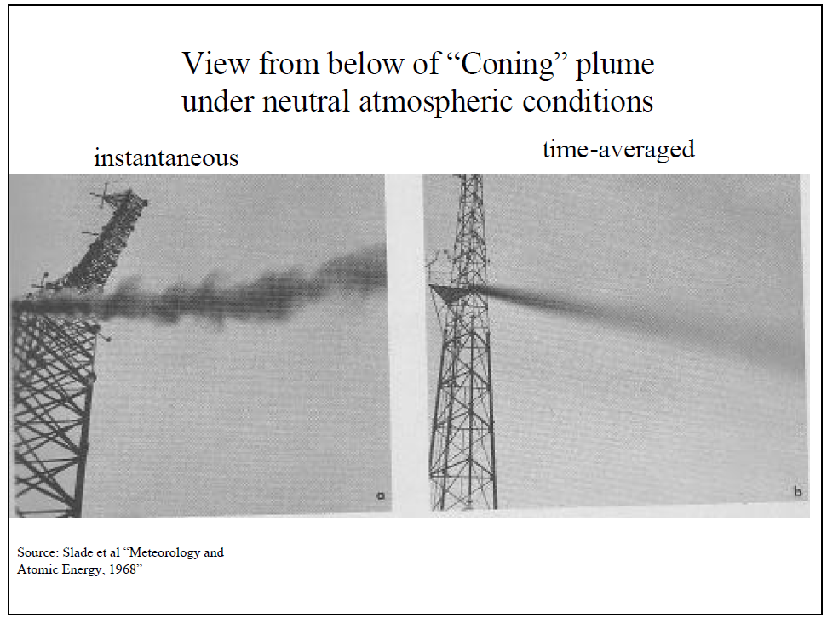
The Point Source Gaussian Plume Model

Slide 36
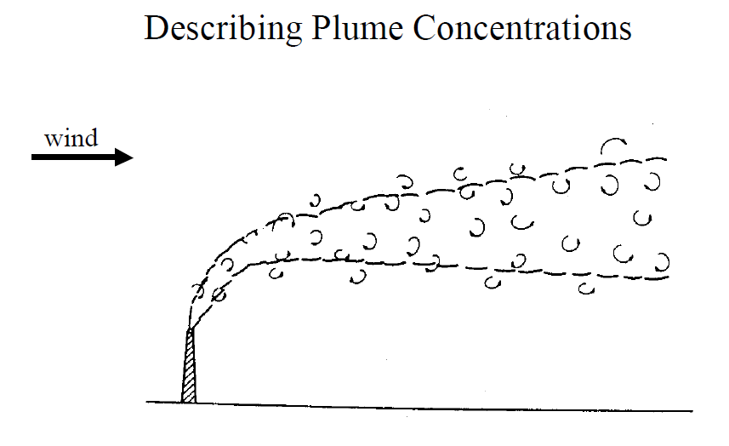

Slide 37
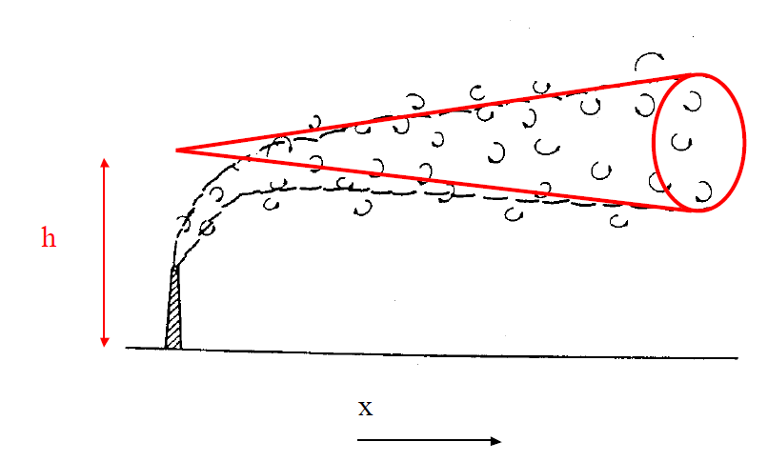

Slide 38
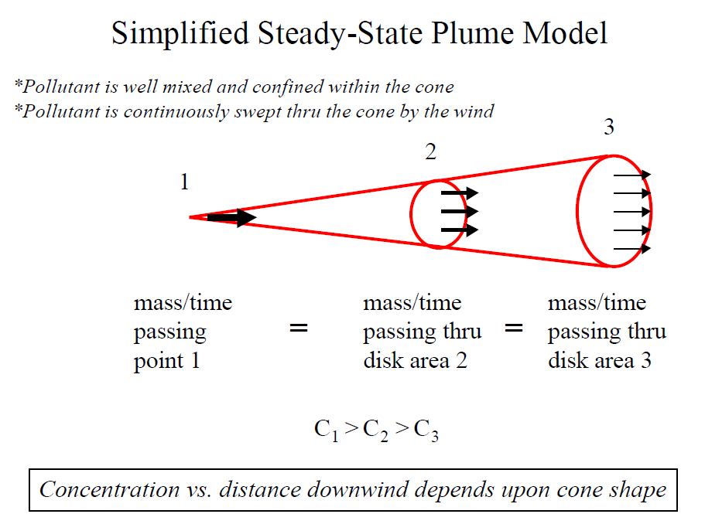

Slide 39
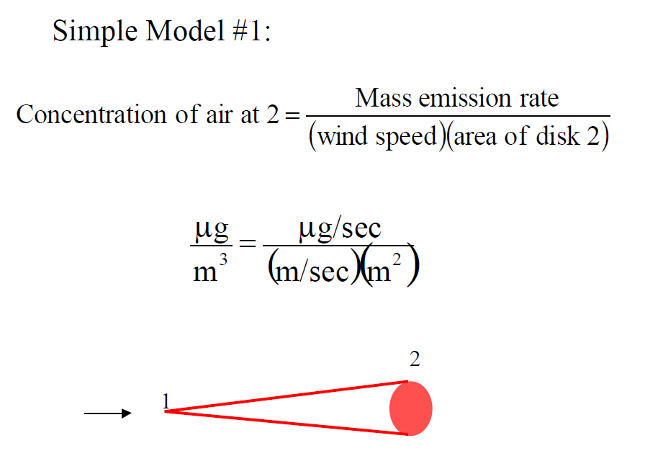

Slide 40
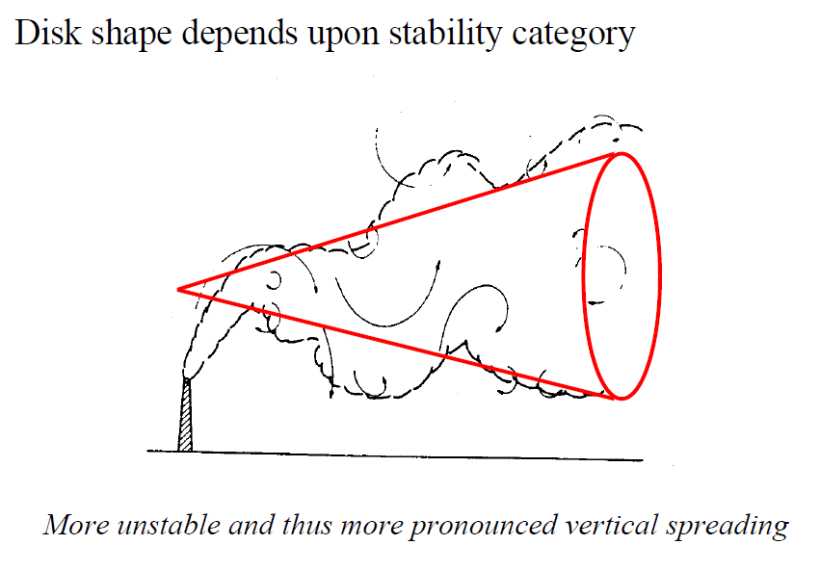
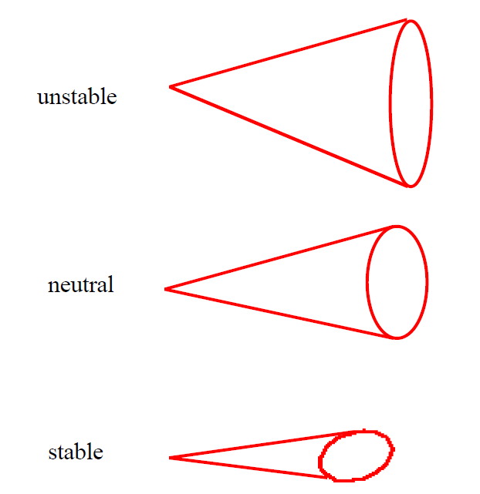

Slide 41
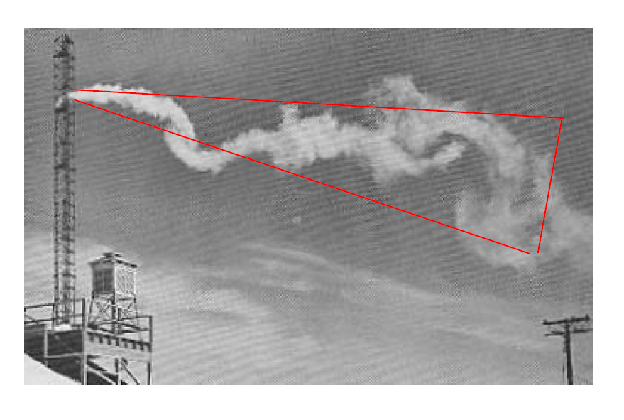

Slide 42
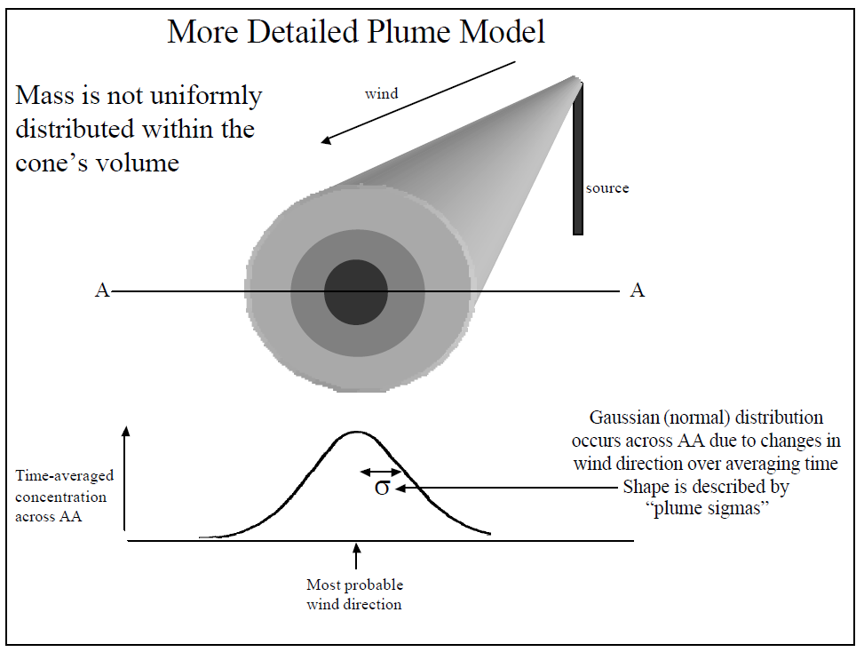

Slide 43
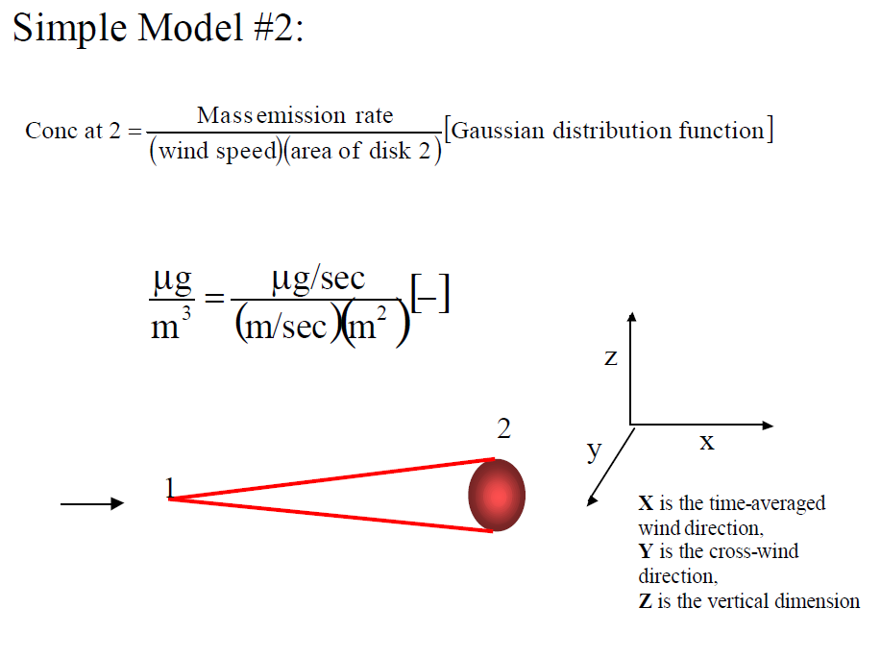

Slide 44
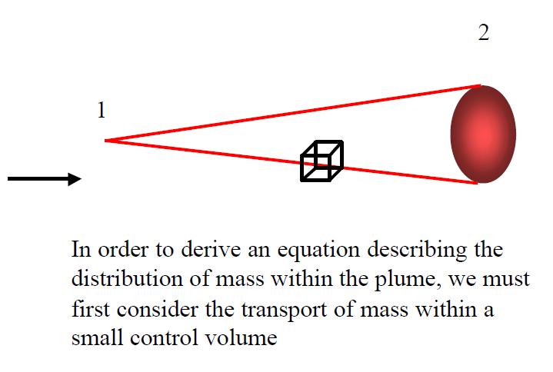
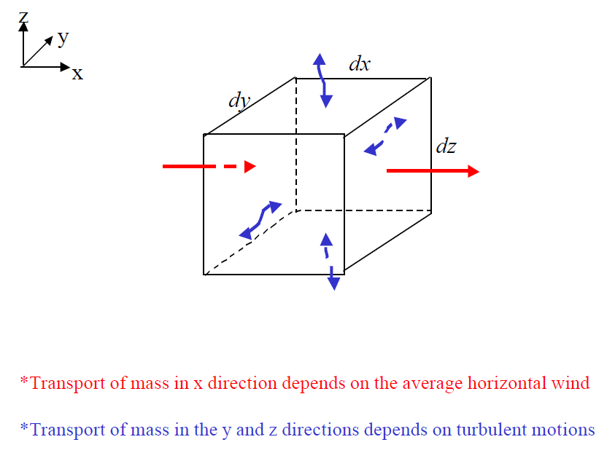

Slide 45
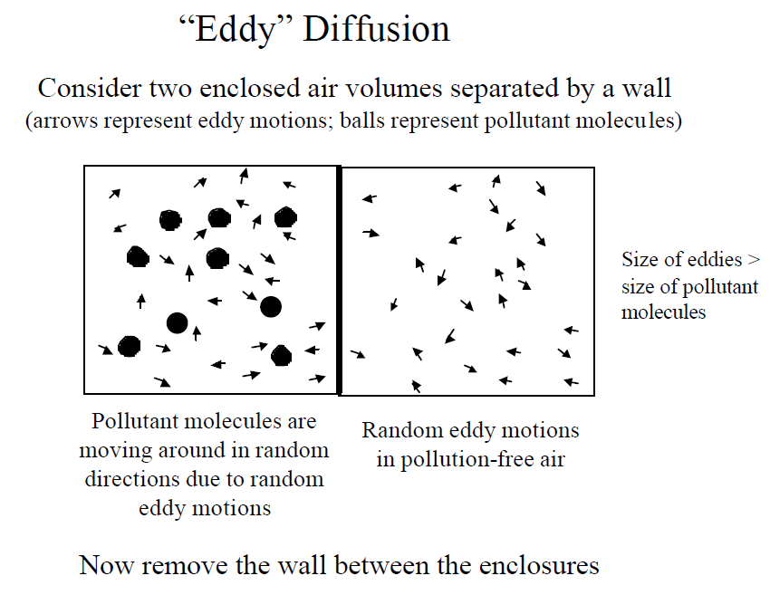

Slide 46
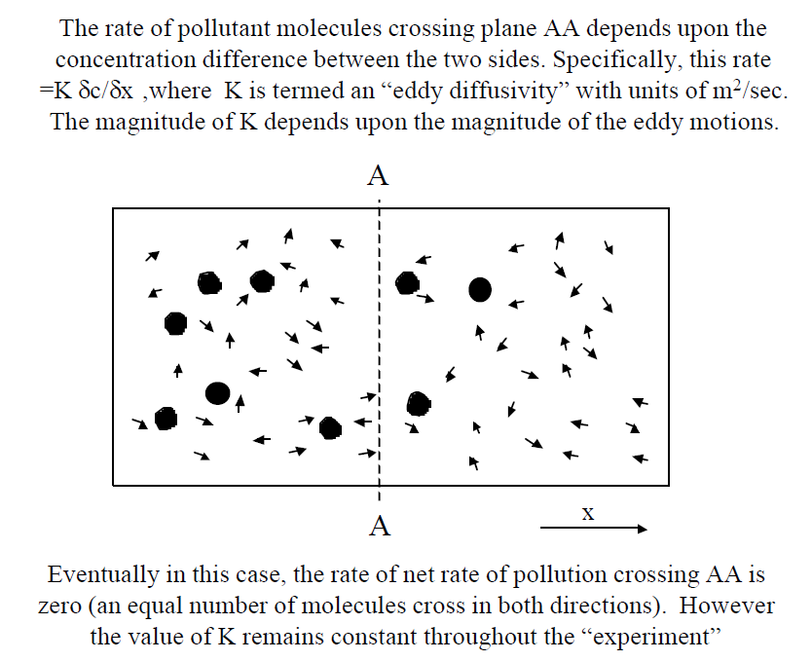

Slide 47
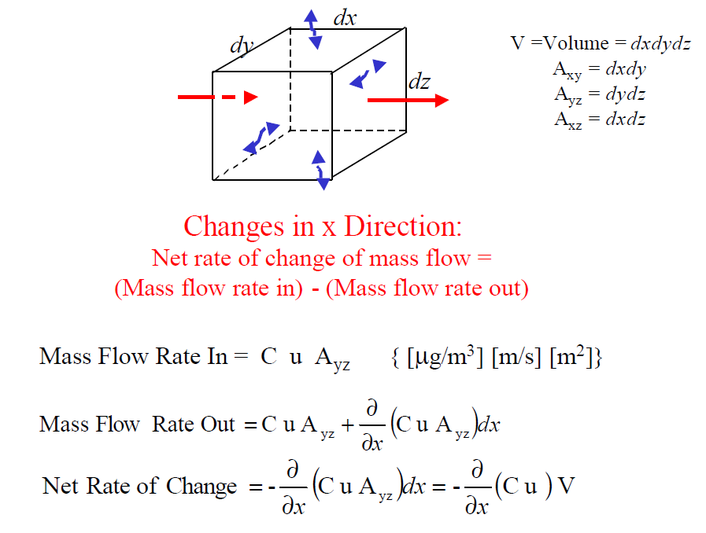

Slide 48
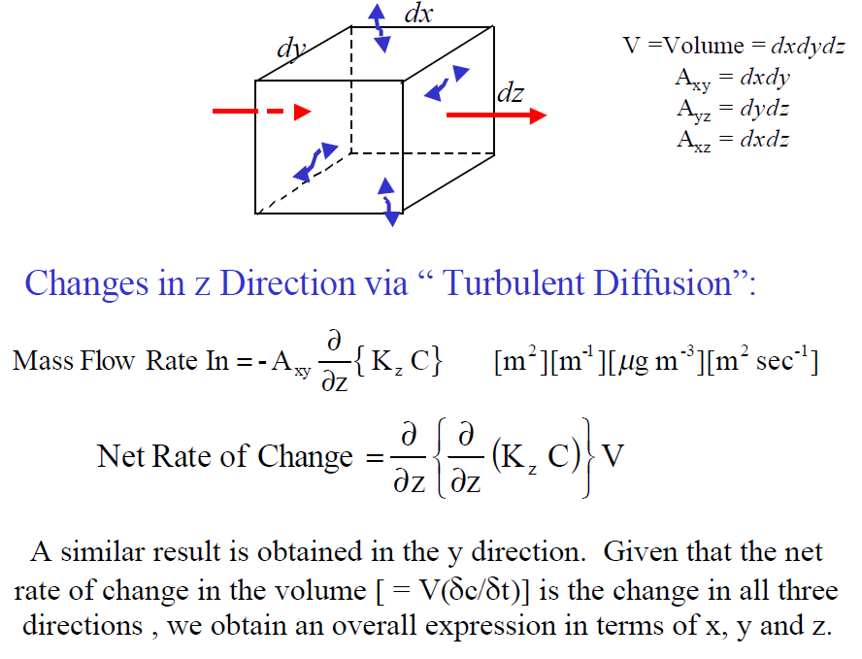

Slide 49
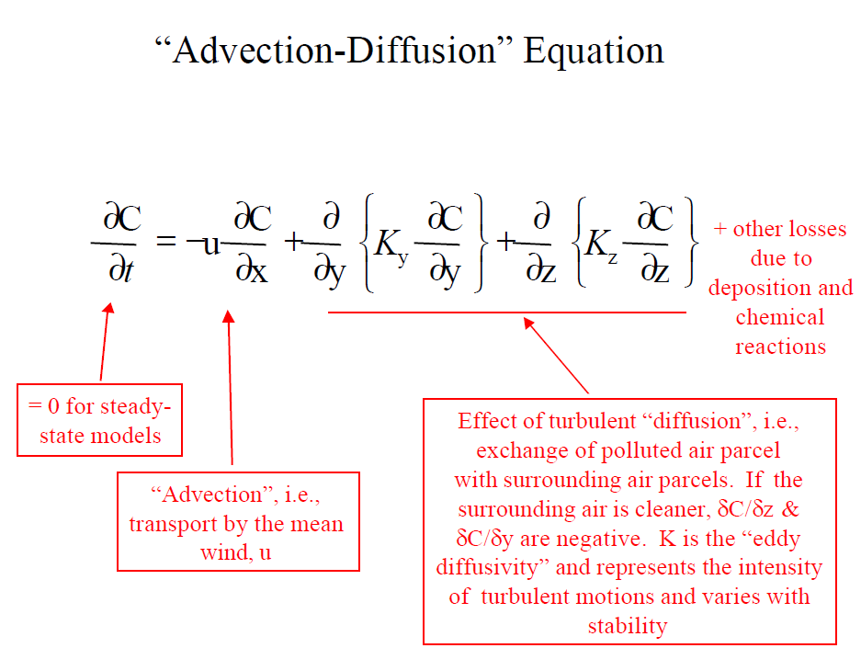

Slide 50
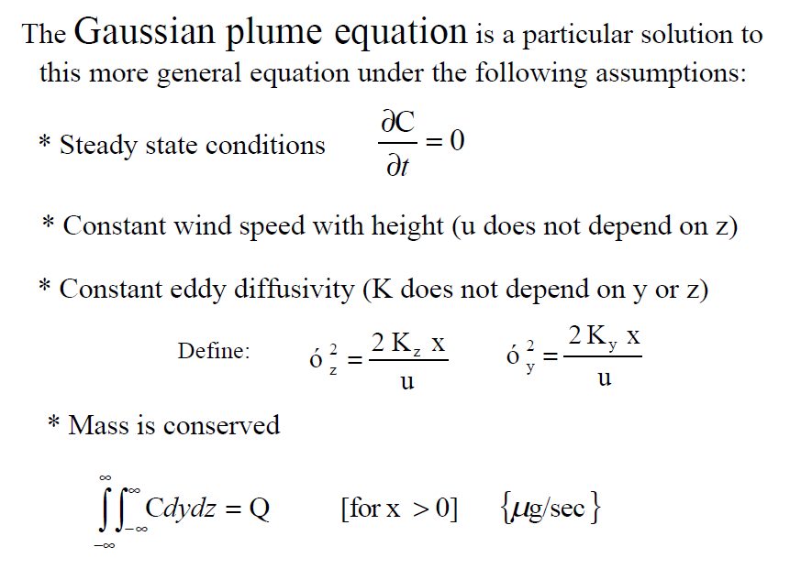

Slide 51
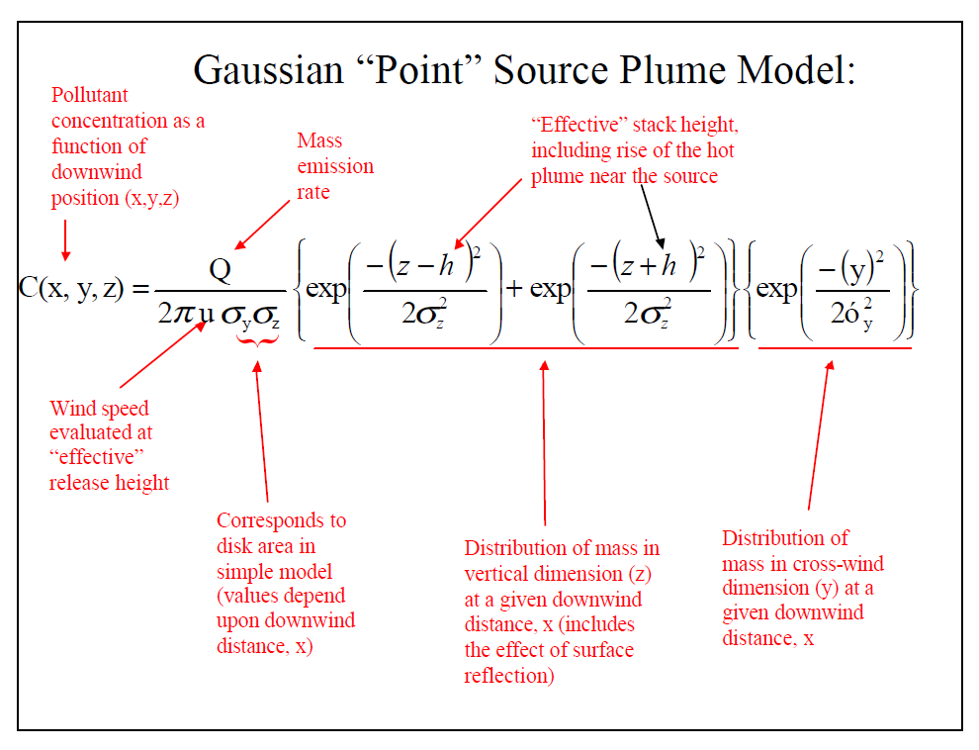

Slide 52
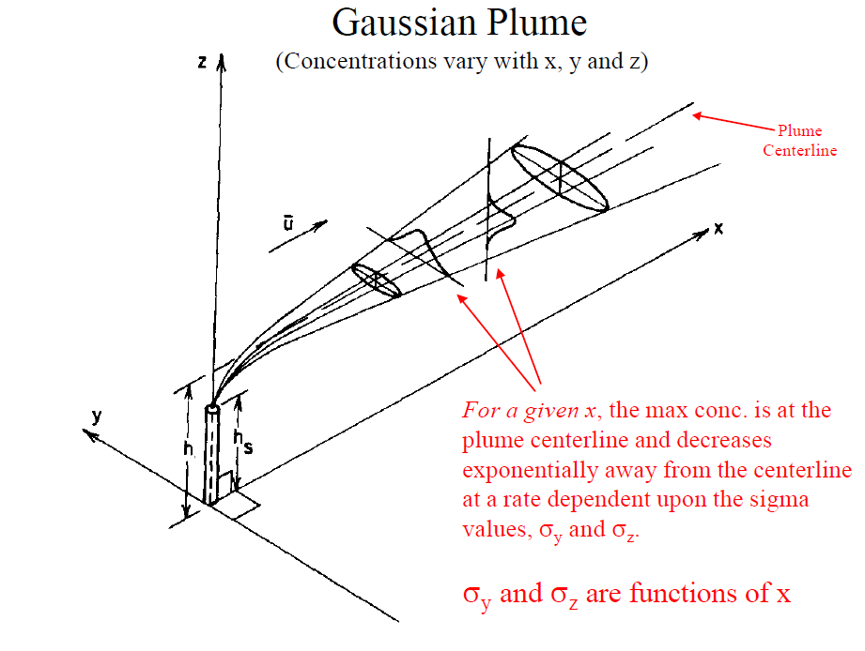

Slide 53
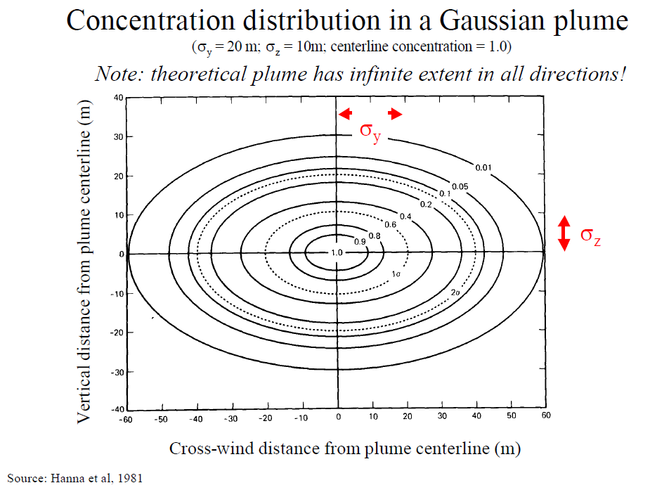

Slide 54
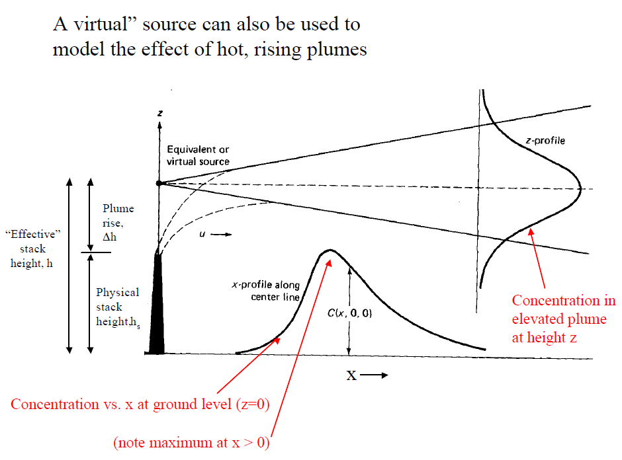

Slide 55
